Slide 1

Smart Card Renewal Process

Slide 2
Agenda
Background
Renewal Process
  Renew Now
  Renew Later
  Renew Never
Renewal Activation Process
  Activate now
  Activate later
  Cancel Activate

Slide 3
Agenda
Expired SmartCard
SmartCard Expiry Report
Activity Log Query
Staff Reporting
  Customer Reports
  Staff User Reports

Slide 4
Background
For Security reasons HSBCnet Smart Cards have a 3 year certificate life span
  The first Smart Card expired in Nov 06
To minimise impact and ensure customers can continue transacting business with HSBCnet without disruption, functionality will be built to advise users that their card will expire and allow them to renew automatically

Slide 5
Renewal Process
45 days prior to the expiry of the Smart Card a renewal window will appear when the user logs onto HSBCnet
3 options will be provided:
  Renew Now – will initiate the renewal process. A new card and PIN will be ordered
  Renew Later – If selected the user will be prompted to renew every time they login.
  Renew Never – User should only select if they do not need their Smart Card after the expiry date

Slide 6
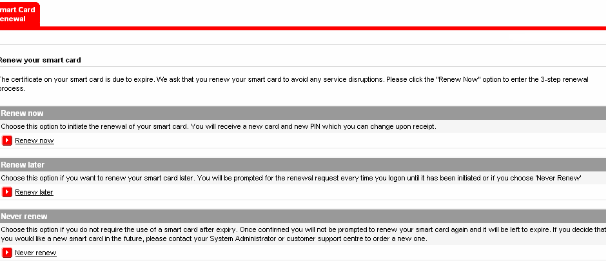
Renewal Process

Slide 7
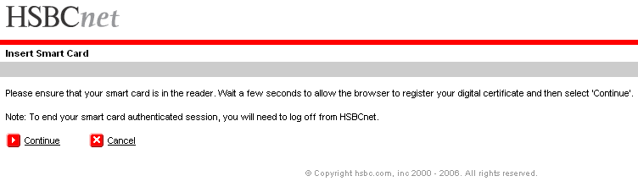
Renewal Process –Renew Now
When a user selects the Renew Now option they will be required to insert their Smart card and go through the authentication process

Slide 8
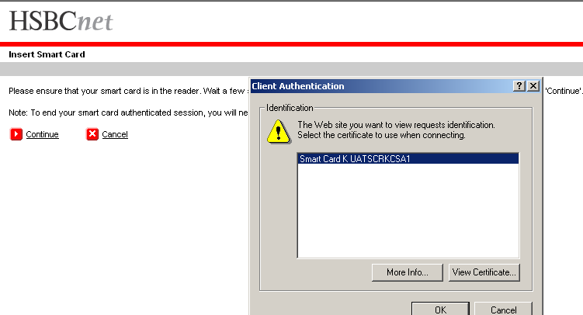
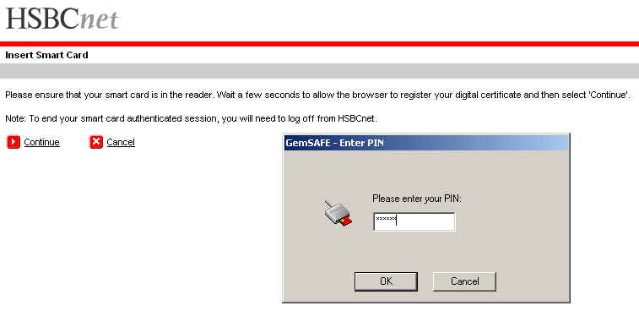
Renewal Process –Renew Now
Select Certificate, enter PIN to access the Renew Now screen

Slide 9
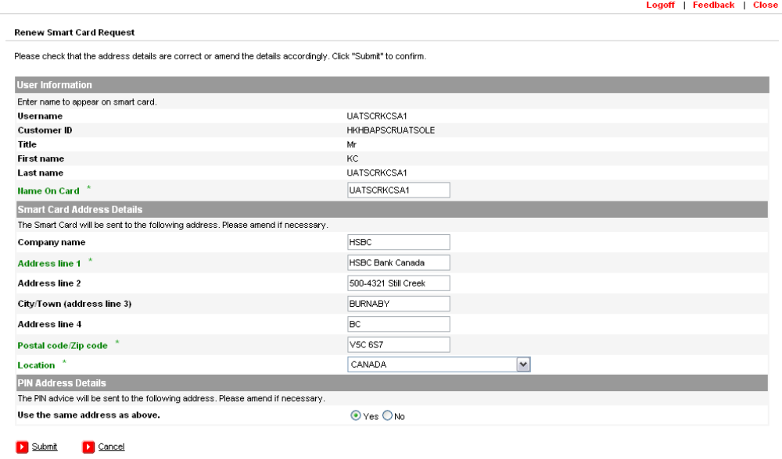
Renewal Process –Renew Now
Once the user has been authenticated they will then be directed to the Renew Smart Card Request page. User to confirm the address details, amend if necessary and “submit”

Slide 10
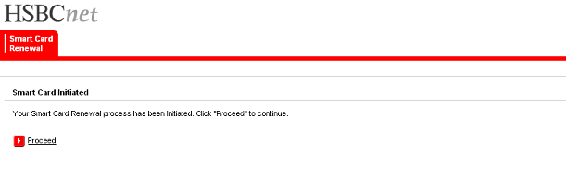
Renewal Process –Renew Now
Confirmation received, click on proceed to complete and proceed to the Personal Page

Slide 11
Renewal Process – Renew Later
When a user selects Renew Later they are directed to their usual Personal Page view.
They will be prompted to renew every time they log into HSBCnet
The prompt will continue until 14 days prior to expiry then the user will be forced to “Renew Now” or “Renew Never”

Slide 12
Renewal Process – Renew Never
A user should only select “Renew Never” if they will no longer need their SmartCard after the expiry date
Once the “Renew Never” process is initiated it cannot be cancelled or reversed
A new card would need to be ordered if a replacement is required in the future

Slide 13
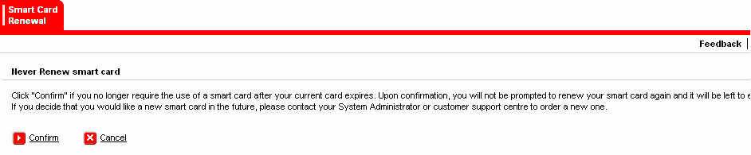
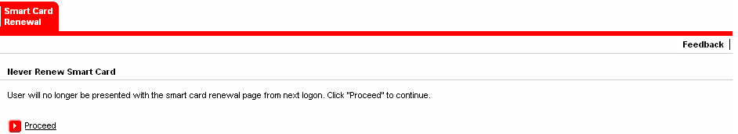
Renewal Process – Renew Never
Click on “confirm” to issue Never Renew instruction” Once Confirmed cannot be cancelled or reversed
Confirmation received. Click on proceed to proceed to the Personal Page

Slide 14
Renewal Activation Process
Once the renewal process has commenced a new card and PIN will be automatically ordered and delivered to the user within 3 – 4 business days
3 options will be provided
  Activate Now
    will revoke existing smartcard
  Activate Later
    select if card and PIN hasn’t been received
  Cancel Renew
    select if card or PIN is lost

Slide 15
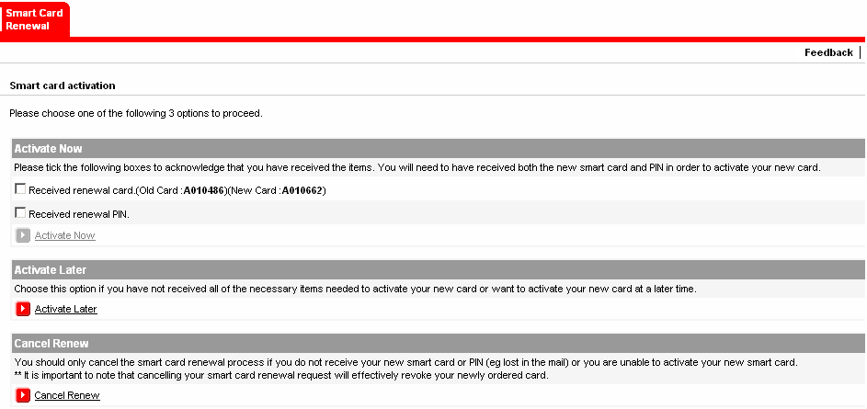
Renewal Activation Process

Slide 16
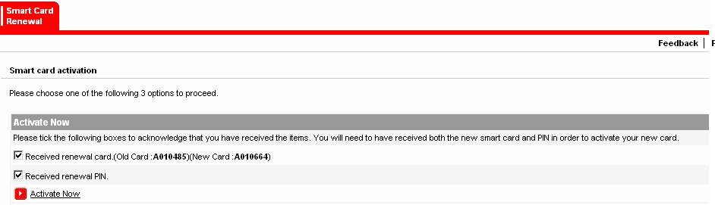
Renewal Activation Process –
Activate Now
User must confirm receipt of both the new card and PIN in order to Activate. Click on the Activate Now button

Slide 17
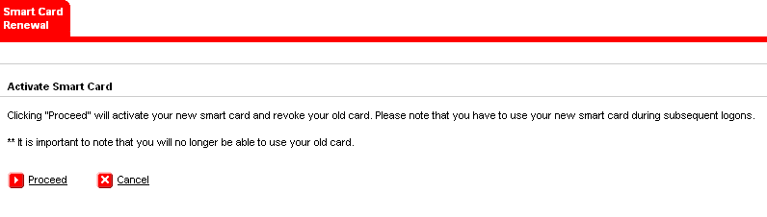
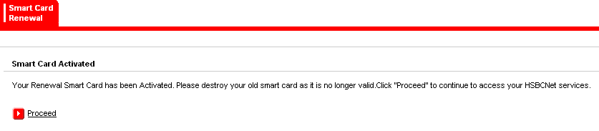
Renewal Activation Process –
Activate Now
Click on Proceed to activate the new card.This will also cancel the old and is not reversible
Confirmation of new card activation is received. Click on Proceed to go to the Personal Page

Slide 18
Renewal Activation Process –
Activate Later
Select “Activate Later” if the user has not yet received their new Card or PIN
Once selected the user will be directed to the Personal Page
Can continue to use old card and PIN until new received and activated or until the expiry date

Slide 19
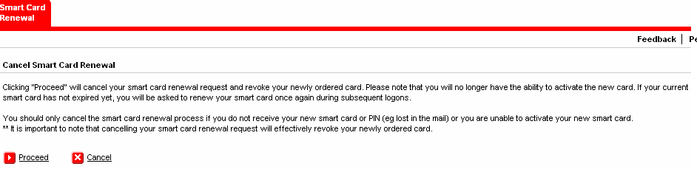
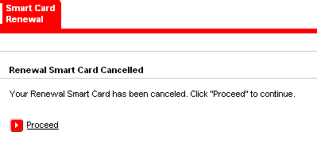
Renewal Activation Process –
Cancel Activate
User to select Cancel Activate if the new card has been lost/stolen or if they cannot activate. If the old card has not yet expired at the next log on they will be directed back to the renewal process screen. Click on proceed.
Confirmation received. Click on proceed to return to the Personal page

Slide 20
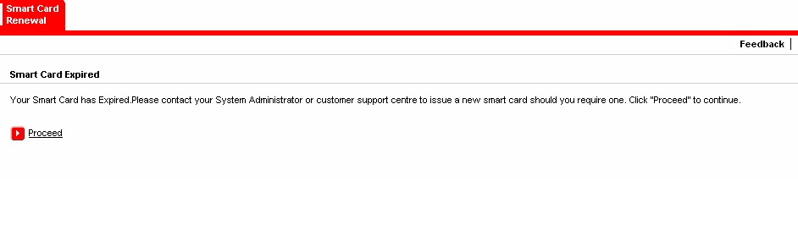
Expired SmartCard
If a user has not logged on during the 45 days preceding the expiry date, once the expiry date has passed when the user tries to log onto HSBCnet they will receive an error message advising that their Smart Card has expired. This message will be provided for a total of 3 log ins after which there will be no more reminders. If the user tries to access any of the tools that require Smart Card authentication, when they try to proceed “this page cannot be displayed” will be received. A new card and PIN must be ordered through the existing process.

Slide 21
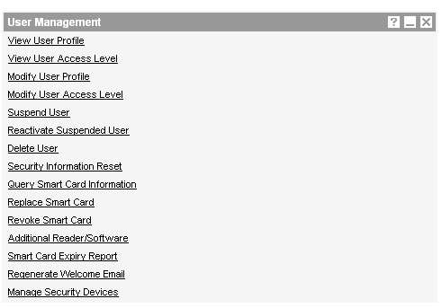
Smart Card Expiry Report
The UMT will also be enhanced to provide System Administrators with a report detailing all SmartCards due to expire within the next 45 days. Staff Users will also have access to the Expiry Reports

Slide 22
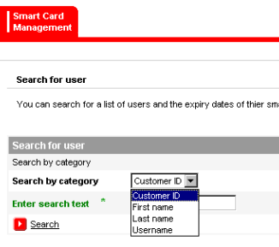
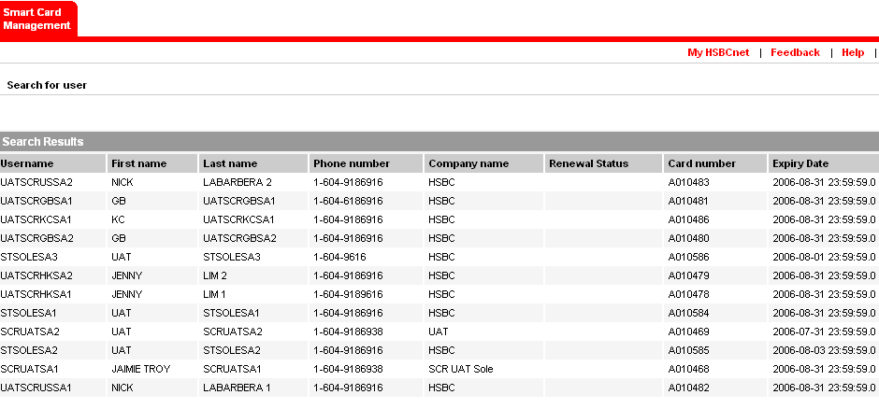
Smart Card Expiry Report
SU are provided search options which are not provided to SA.
A report listing all Smart Cards expiring over the next 45 days will be displayed including user details, card number, expiry date and the status once the renewal process has been commenced.

Slide 23
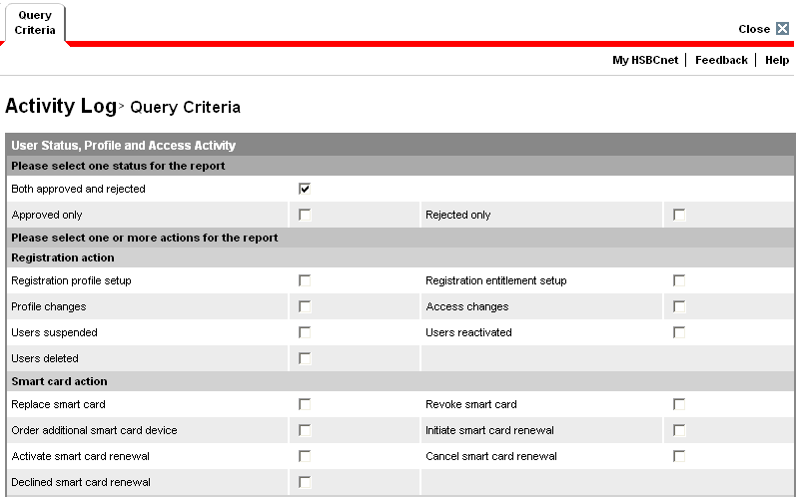
Activity Log Query
The Activity Log Querywill allow SA’s to perform enquiries on the Smart Card Renewal and Activation process

Slide 24
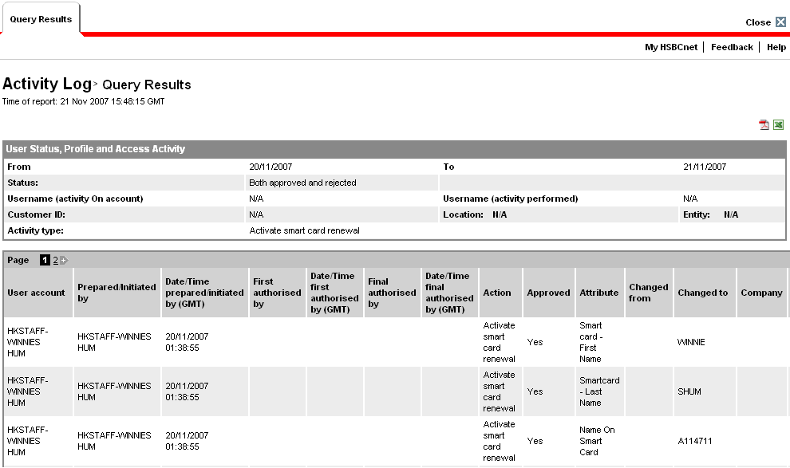
Activity Log Query
Results of the Activity Log Query

Slide 25
Staff Reporting
Customer Reports
  To assist Help Desk staff identify those customers that have Smart Cards expiring in the following 90 days a monthly report will be provided by the KC Information Management Team
  The report is an information only report and individual areas can choose how they wish to use the information i.e.: proactively or not (please refer to your own internal procedures)
  Provided on the 1st of each month
  E-mail delivery to individual support areas via COGNOS
  Displays cards expiring in 5,10,15,20,25,30,60 and 90 days

Slide 26
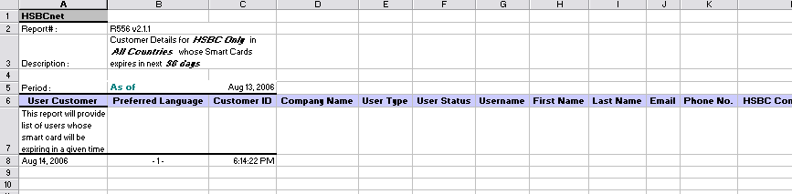

Staff Reporting
Example of Customer Reports
Example of the customer reports.

Slide 27
Staff Reporting
Staff User Reports
  A report detailing all Staff Users with SmartCards expiring within 30 days
  The KC IM team will manage the report monthly through an information flash to those areas effected

Slide 28
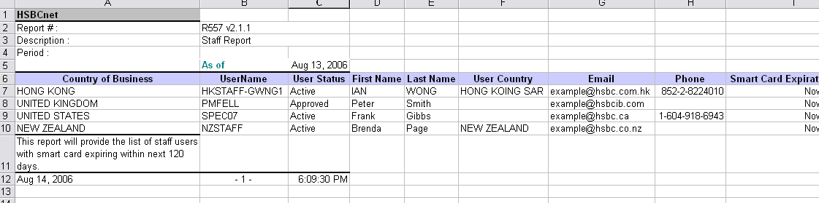

Staff Reporting
Example of Staff User Reports
Example of the staff user reports.

